Slide 1
Bottle Opener
By: Connor Loudermilk & Anthony Lane

Slide 2
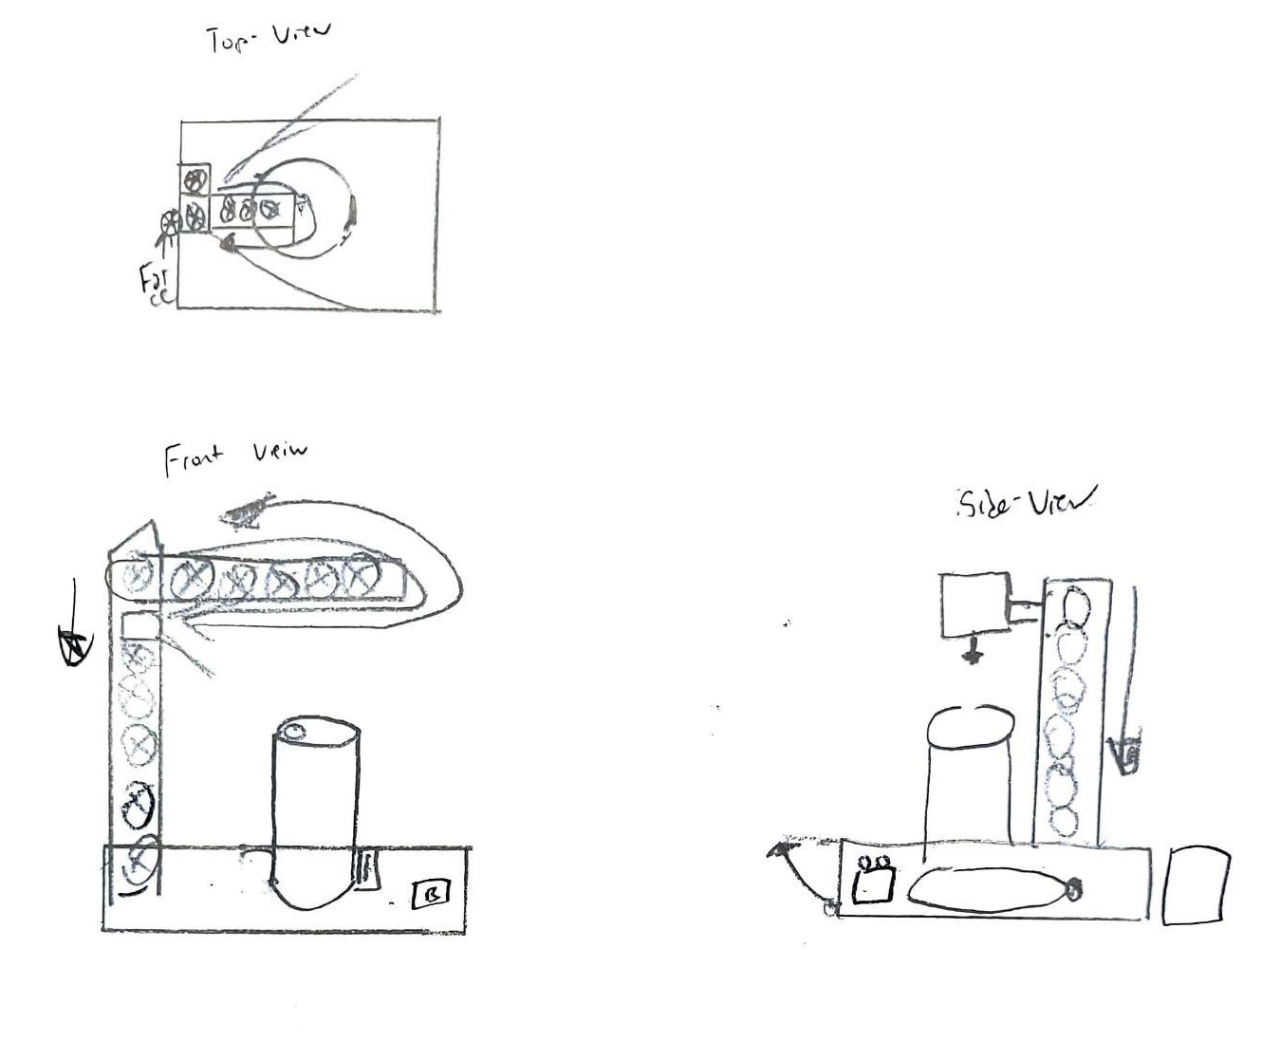
Bottle Opener
Alpha - Edition
Components: ** = Optional
Sensor (red light) - measures distance
Large Motor (Sunroof motor) 12V - movement across cog system
Small motor (Pi motor) - movement across cog system
Button - activation of vertical adjustment and can opening
**Pressure Pad - serve as precursor, conditional to determine if can is present
Bread Board
Pi
Base part 1 (capsule to hold components: breadboard, pi, pressure pad, button)
**Base part 2 (Piece of base that coke sits upon)
**Styrofoam pad to protect pressure pad
Triangular item to open can
Vertical Frame
Horizontal Frame
Cogs
12V power source (12V battery)
Electrical coil switch (activated by pi between batteries and motor
Resistors
Wiring
Coil for battery terminals

Slide 3
Concept:
There will be two motors, one in control of vertical motion, and one in control of horizontal motion. The horizontal motion will be track based, with the vertical motion being a pillar that gets lifted via a cog mechanism inside of the vertical beam.
Once the opening process is initiated the vertical track will begin lowering the horizontal beam, until it reaches the height of the can.
There will be a sensor inside of the vertical beam that tracks whether there is an object in front of it, or not. If an object is detected, the vertical motion will stop, and the horizontal motion will begin. Extending a triangular structure to slide under the lid of the can and pop the tab open.
Upon opening the can, the vertical beam will begin moving the horizontal beam back upwards into its original position.
Currently the idea is to initiate the process with a button. Alternative ideas for beginning the process include using a pressure pad system, or using a sensor that views downward (this would be placed on the horizontal beam).

Slide 4
Final Edition:
Soda Can Opener
Anthony Lane & Connor Loudermilk

Slide 5
Intended Application
Step 1- Place beverage can in area.
Step 2- Once can is correctly place, press button.
This will tell the sensor to start operating. The sensors purpose is to lower upon can height.
Step 3- The can’s presence is sensed. The vertical motion stops.
Powered by motor
Step 4- Horizontal motion begins.
This piece holds the physical opener for the can.
The opener will slide across/under the tab of the can cracking it open.
Step 5- The can has now been opened. The mechanism will now go back in place.
Full rotation of horizontal movement.
Height will go increase based on time it lowered
Step 6- Retrieve can and enjoy.

Slide 6
GitHub URL
Anthony/Connor./Soda.Can Opener/ (github.com)

Slide 7
Final Goals and Objectives

Slide 8
Goals/Objectives
Sensor reads where the can is, then lowers to desired amount.
Elevator lowers to desired amount.
Once elevator reaches desired height, horizontal motion begins.
Horizontal motion is a track that holds the soda can open. It will slide underneath the tab pulling it upwards until the can is cracked.

Slide 9
Objectives/Timelines over 6 weeks
(*= not original objective)
Create base model with 3D Printing
Create code
Test Code
Work on 2nd model of project
Incorporate everything (FAIL)
Buy stronger motors*
Create 3rd model
Implement components together (motor too heavy, FAIL)
Create 4th/ final model*
Implement all components together
Test

Slide 10
GPIO Layout and Circuit Diagram

Slide 11
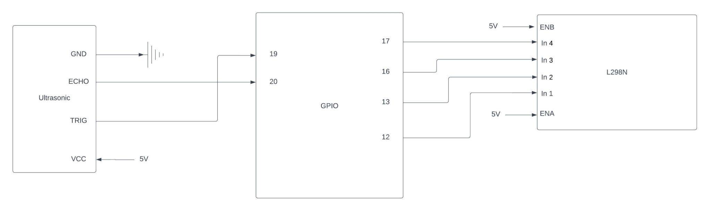
GPIO Layout

Slide 12
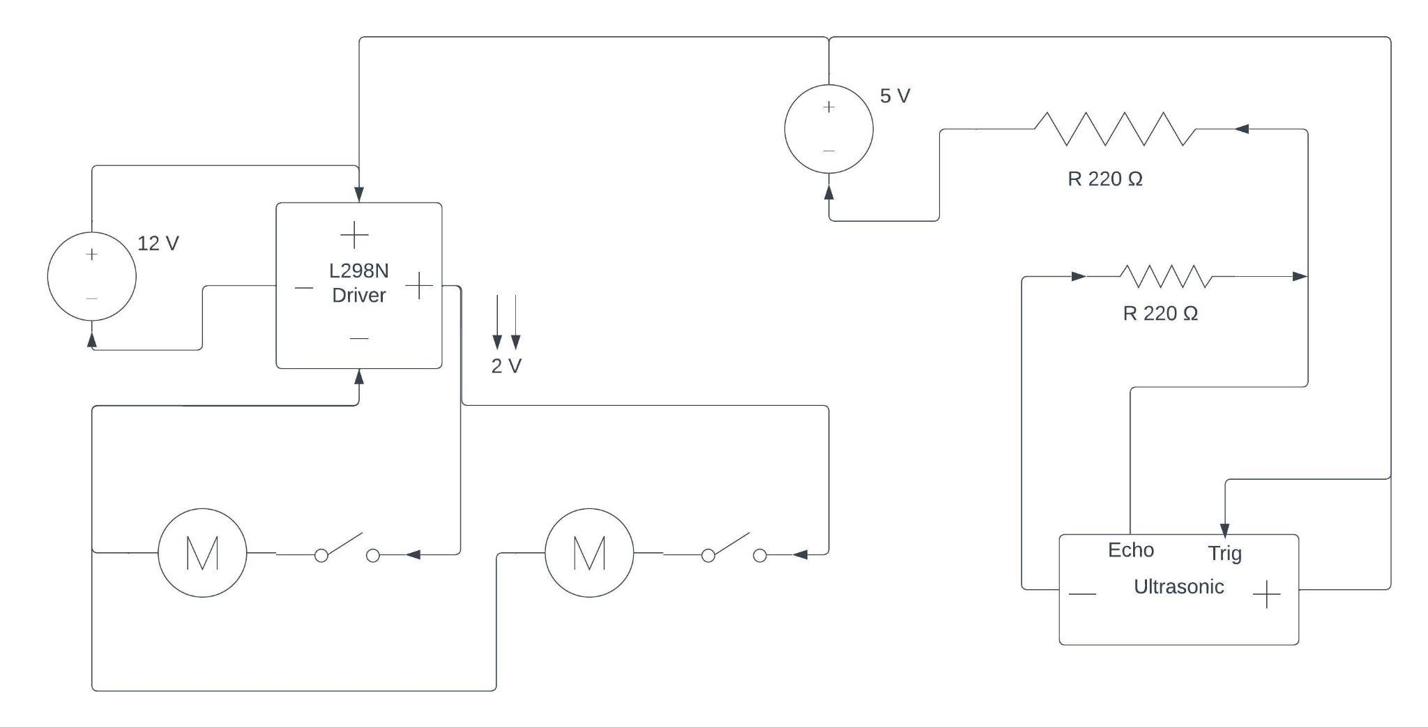
Circuit Diagram

Slide 13
Future Development Plans
Stronger elevator components
More extensive planning
Stronger tracks for horizontal motion
Lower weight, and stronger functioning motor
Allow for an adaptive can holder so it works on a variety of cans
HIgher success rate than 10%

Slide 14
Lessons Learned
Motors and base work hand in hand together (need a stable base for motors to operate properly)
Some motors are easier to program than others.
Identifying torque and motor requirements are needed for determining motor driver.
Trial and error is necessary
Although something may work on paper there will be errors
Incorporate the errors the fix the total project, some errors are more relevant than others and can be fixed by fixing the bigger error.
Fix simple errors in code earlier on.
Create separate files to test functionality of hardware individually.
Plug in breadboard before testing new motors.

Slide 15
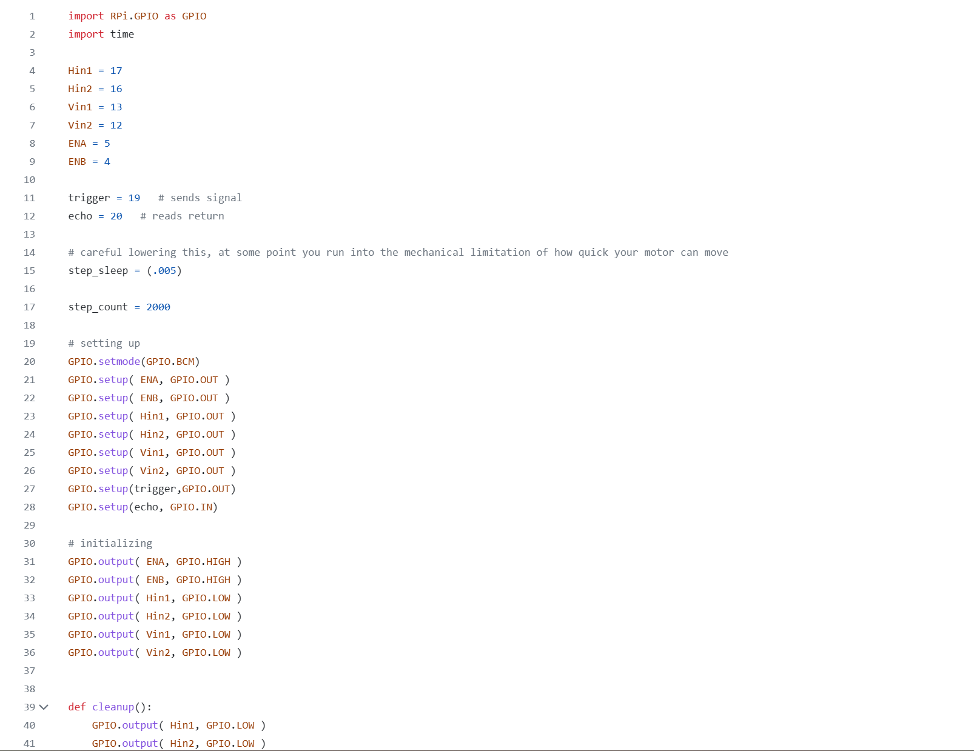
Source Code

Slide 16
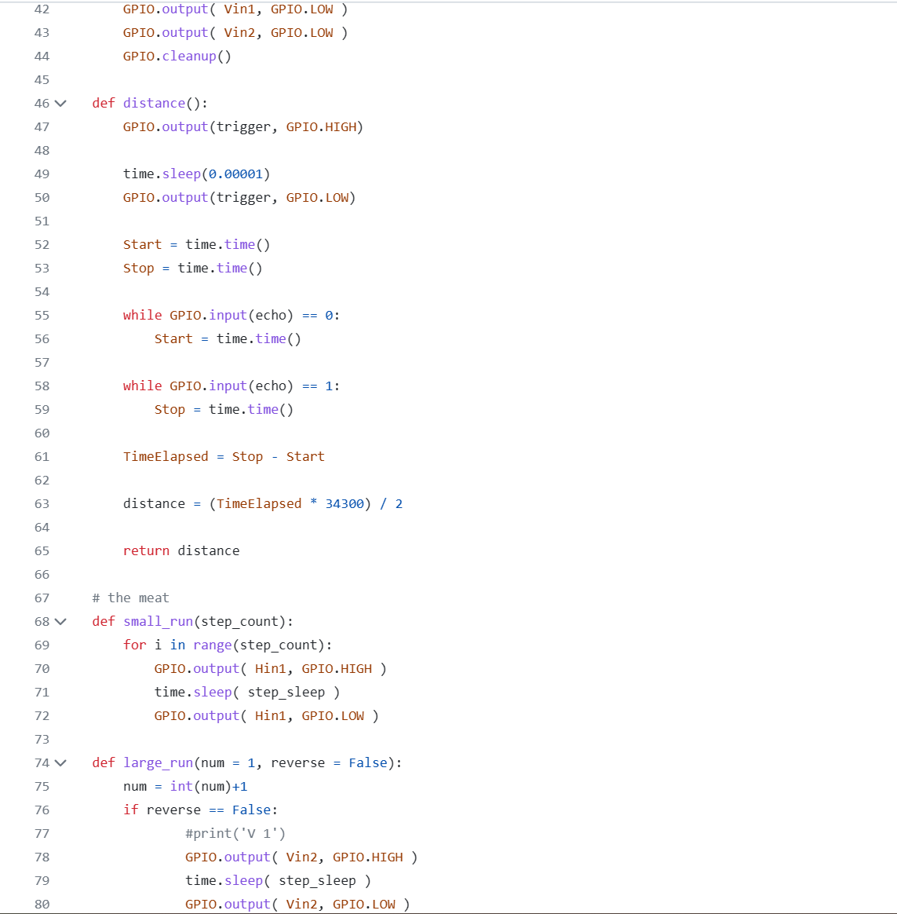

Slide 17
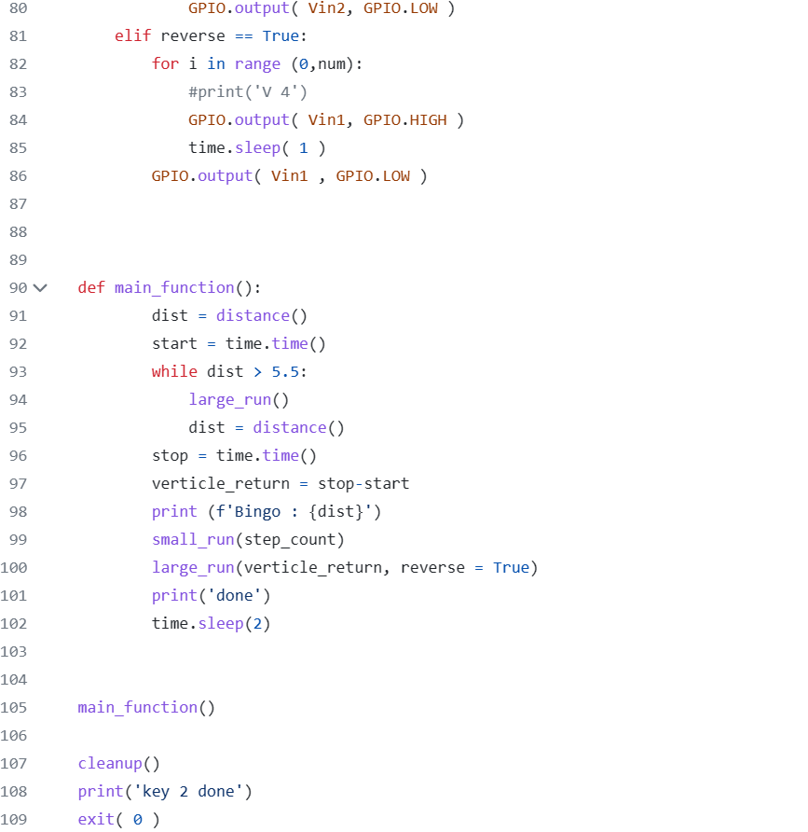

Slide 18
Relevant Documentation
Motor Driver:
https://asset.conrad.com/media10/add/160267/c1/-/en/001525437ML01/manual-1525437-iduino-st-1112-motor-controller-1-pcs.pdf
Motor:
https://www.amazon.com/Greartisan-Electric-Reduction-Centric-Diameter/dp/B089GTHGPZ?th=1

Slide 19
Materials (notes, slides, Etc)
BASE: Wooden slats, rope, dowels, conveyor belt track, wood, , staples, nails, glue, styrofoam, counter weight
GPIO: Jumper wires, L298N, Ultrasonic Sensor, 220 resistors

